Slide 1
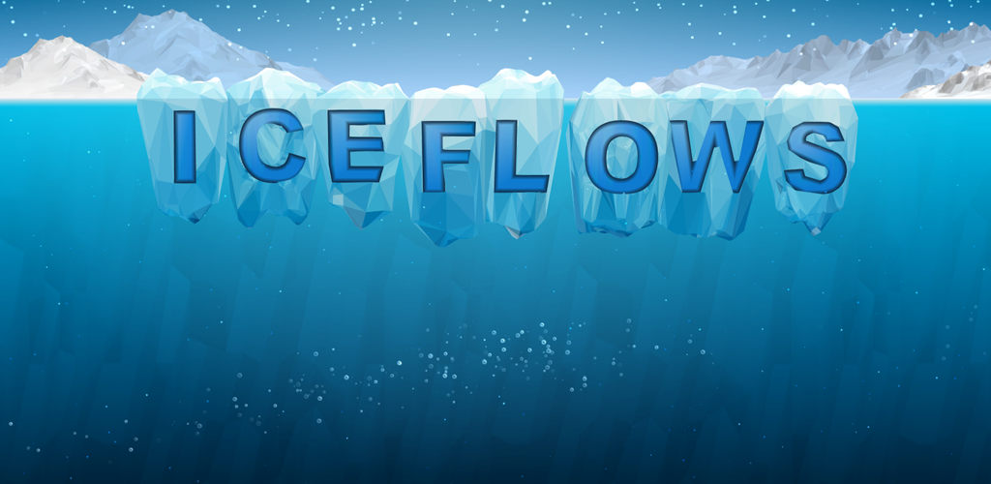

Lesson 1:
The Cryosphere

Slide 2

Cryosphere

Slide 3
What do we mean by the term cryosphere?
Discuss the definition of the cryosphere…

Slide 4
Which sphere am I?
Complete the Which Sphere am I? activity sheet

Slide 5
Where is the cryosphere?
Use an Atlas to fill in the relevant area on your blank world map

Slide 6
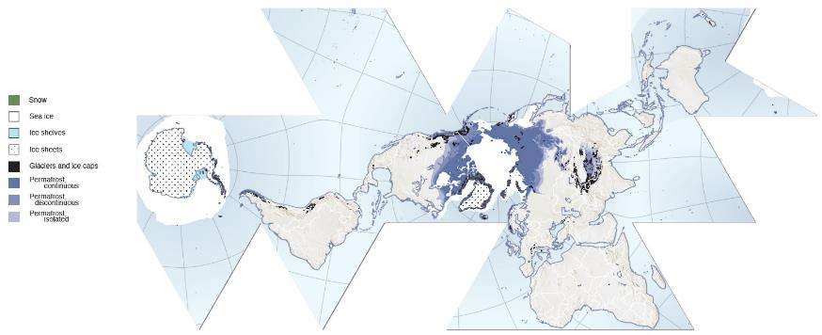
With thanks to Hugo Ahlenius, UNEP/GRID-Arendal
http://www.grida.no/resources

Slide 7
Ice Sheet

Slide 8
Ice Shelf

Slide 9
Ice cap

Slide 10
Glacier

Slide 11
Permafrost

Slide 12
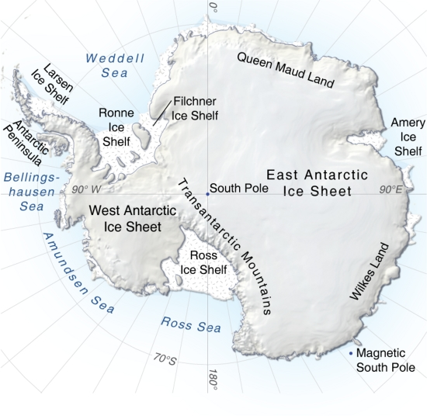
Antarctica
With thanks to Hugo Ahlenius, UNEP/GRID-Arendal
http://www.grida.no/resources/5231

Slide 13
Filchner-Ronne Ice Shelf
With thanks to Hugo Ahlenius, UNEP/GRID-Arendal
http://www.grida.no/resources/5231

Slide 14
Homework: Stories of Changing Ice

Slide 15
Game website http://www.iceflowsgame.com
Ice Flows Game Teacher Resource

Slide 16

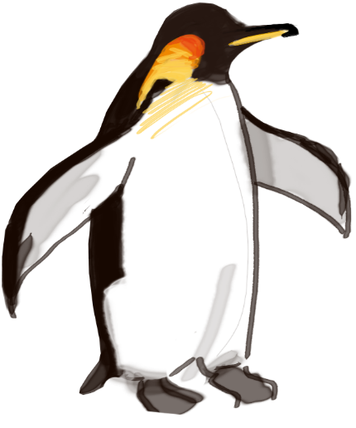
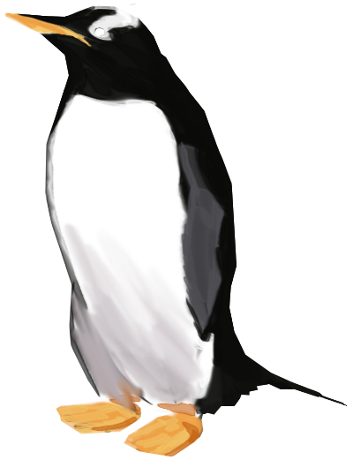
Thanks for playing!

